Slide 1
ATAI
Advanced Technique of Artificial Intelligence
ATAI
ChongqingUniversity _{AdvancedTechniqueof}
of Technology Artificial Intelligence
Chongqing University of
Technology
Chongqing University ^{ATAI}
_{of Technology} Advanced Techniqueof
Artificial Intelligence
Chongqing University of Technology
Chongqing University of Technology
Multimodal Chain-of-Thought Reasoning
in Language Models
Code: https://github.com/amazon-science/mm-cot
--WestlakeNLP、FudanNLP会议分享
2023.03
Reported by JiXiang Fang
1

Slide 2
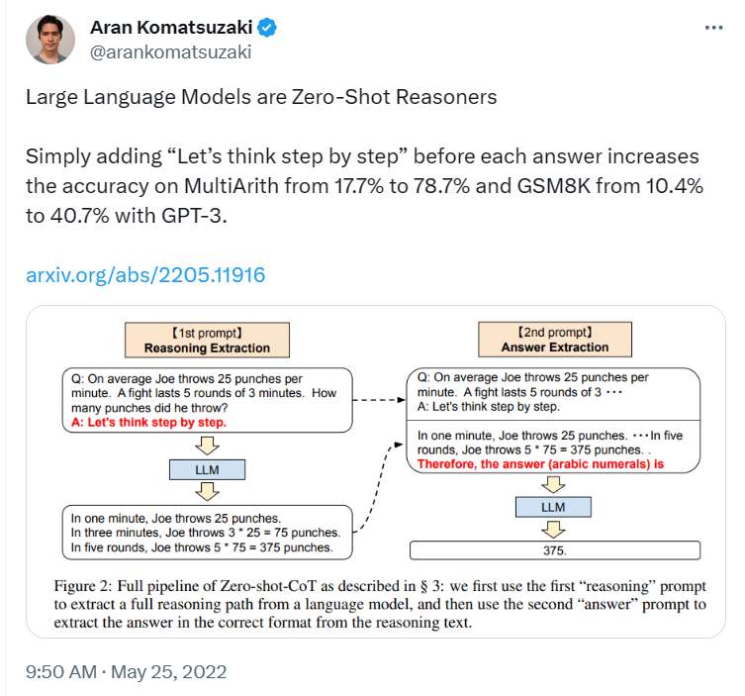
ATAI
Advanced Technique of Artificial Intelligence
ATAI
ChongqingUniversity _{AdvancedTechniqueof}
of Technology Artificial Intelligence
Chongqing University of
Technology
Chongqing University ^{ATAI}
_{of Technology} Advanced Techniqueof
Artificial Intelligence
Chongqing University of Technology
Chongqing University of Technology
Motivation
(1) Existing studies related to CoT reasoning are largely isolated in the language modality ,with little consideration of multimodal scenarios. To elicit CoT reasoning in multimodality, we advocate a Multimodal-CoT paradigm.
What is Chain-of-Thought (CoT)?

Slide 3
ATAI
Advanced Technique of Artificial Intelligence
ATAI
ChongqingUniversity _{AdvancedTechniqueof}
of Technology Artificial Intelligence
Chongqing University of
Technology
Chongqing University ^{ATAI}
_{of Technology} Advanced Techniqueof
Artificial Intelligence
Chongqing University of Technology
Chongqing University of Technology
Motivation

Slide 4
ATAI
Advanced Technique of Artificial Intelligence
ATAI
ChongqingUniversity _{AdvancedTechniqueof}
of Technology Artificial Intelligence
Chongqing University of
Technology
Chongqing University ^{ATAI}
_{of Technology} Advanced Techniqueof
Artificial Intelligence
Chongqing University of Technology
Chongqing University of Technology
Motivation

Slide 5
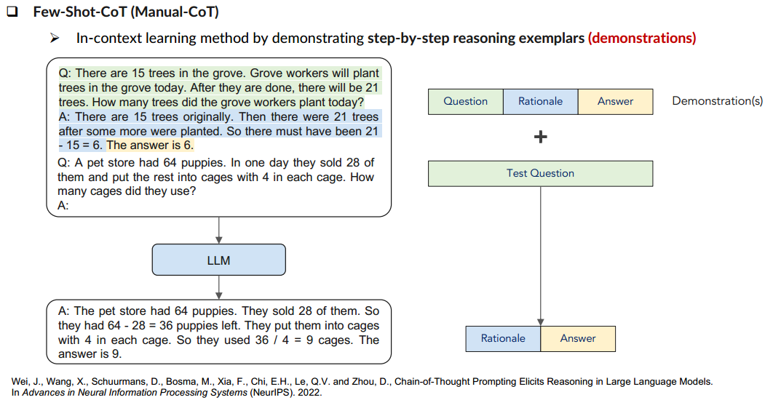
ATAI
Advanced Technique of Artificial Intelligence
ATAI
ChongqingUniversity _{AdvancedTechniqueof}
of Technology Artificial Intelligence
Chongqing University of
Technology
Chongqing University ^{ATAI}
_{of Technology} Advanced Techniqueof
Artificial Intelligence
Chongqing University of Technology
Chongqing University of Technology
Motivation

Slide 6
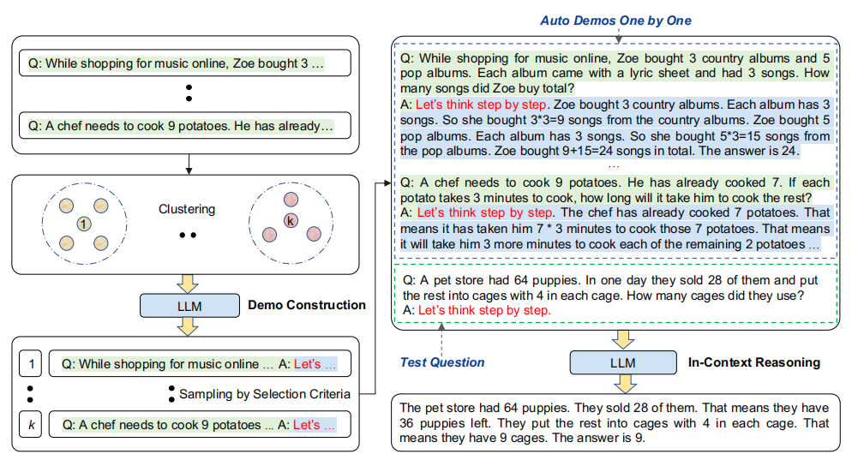
ATAI
Advanced Technique of Artificial Intelligence
ATAI
ChongqingUniversity _{AdvancedTechniqueof}
of Technology Artificial Intelligence
Chongqing University of
Technology
Chongqing University ^{ATAI}
_{of Technology} Advanced Techniqueof
Artificial Intelligence
Chongqing University of Technology
Chongqing University of Technology
Motivation

Slide 7
ATAI
Advanced Technique of Artificial Intelligence
ATAI
ChongqingUniversity _{AdvancedTechniqueof}
of Technology Artificial Intelligence
Chongqing University of
Technology
Chongqing University ^{ATAI}
_{of Technology} Advanced Techniqueof
Artificial Intelligence
Chongqing University of Technology
Chongqing University of Technology
Motivation
(2) In general, there are two ways to elicit Multimodal-CoT reasoning as follows:
(i) prompting LLMs
(ii) fine-tuning small models.
(3) To facilitate the interaction between modalities, another potential solution is to fine-tune smaller language models by fusing multimodal features .As this approach allows the flexibility of adjusting model architectures to incorporate multimodal features, we study fine-tuning models in this work instead of prompting LLMs.
(4) The key challenge is that language models under 100 billion
parameters tend to generate hallucinated rationales that mislead the answer inference.

Slide 8
ATAI
Advanced Technique of Artificial Intelligence
ATAI
ChongqingUniversity _{AdvancedTechniqueof}
of Technology Artificial Intelligence
Chongqing University of
Technology
Chongqing University ^{ATAI}
_{of Technology} Advanced Techniqueof
Artificial Intelligence
Chongqing University of Technology
Chongqing University of Technology

Slide 9
ATAI
Advanced Technique of Artificial Intelligence
ATAI
ChongqingUniversity _{AdvancedTechniqueof}
of Technology Artificial Intelligence
Chongqing University of
Technology
Chongqing University ^{ATAI}
_{of Technology} Advanced Techniqueof
Artificial Intelligence
Chongqing University of Technology
Chongqing University of Technology

Slide 10
ATAI
Advanced Technique of Artificial Intelligence
ATAI
ChongqingUniversity _{AdvancedTechniqueof}
of Technology Artificial Intelligence
Chongqing University of
Technology
Chongqing University ^{ATAI}
_{of Technology} Advanced Techniqueof
Artificial Intelligence
Chongqing University of Technology
Chongqing University of Technology

Slide 11
ATAI
Advanced Technique of Artificial Intelligence
ATAI
ChongqingUniversity _{AdvancedTechniqueof}
of Technology Artificial Intelligence
Chongqing University of
Technology
Chongqing University ^{ATAI}
_{of Technology} Advanced Techniqueof
Artificial Intelligence
Chongqing University of Technology
Chongqing University of Technology

Slide 12
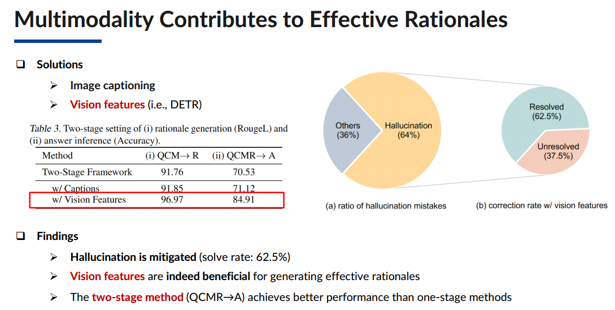
ATAI
Advanced Technique of Artificial Intelligence
ATAI
ChongqingUniversity _{AdvancedTechniqueof}
of Technology Artificial Intelligence
Chongqing University of
Technology
Chongqing University ^{ATAI}
_{of Technology} Advanced Techniqueof
Artificial Intelligence
Chongqing University of Technology
Chongqing University of Technology

Slide 13
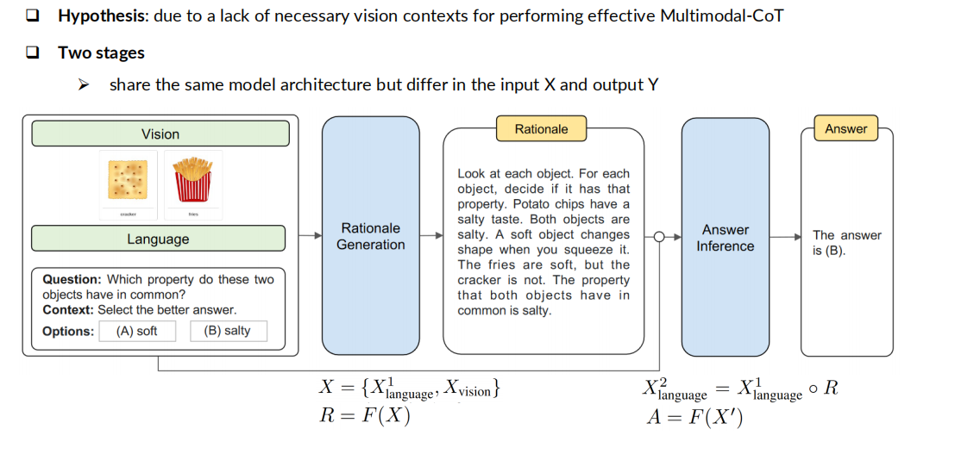
ATAI
Advanced Technique of Artificial Intelligence
ATAI
ChongqingUniversity _{AdvancedTechniqueof}
of Technology Artificial Intelligence
Chongqing University of
Technology
Chongqing University ^{ATAI}
_{of Technology} Advanced Techniqueof
Artificial Intelligence
Chongqing University of Technology
Chongqing University of Technology
Overview

Slide 14
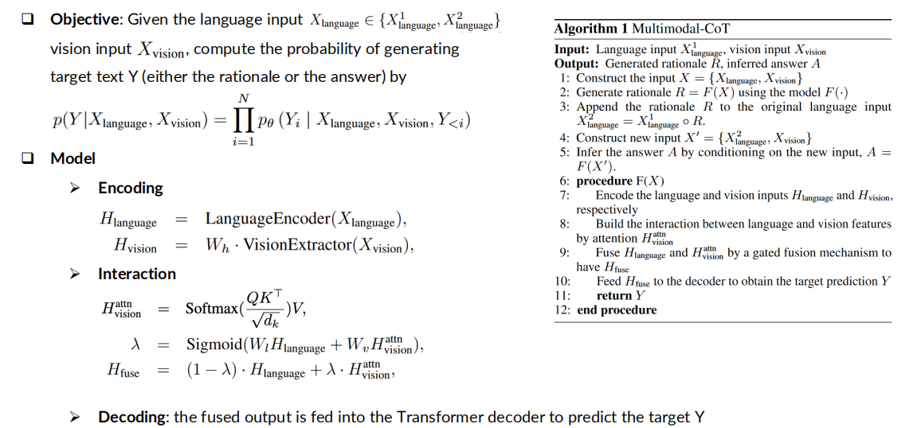
ATAI
Advanced Technique of Artificial Intelligence
ATAI
ChongqingUniversity _{AdvancedTechniqueof}
of Technology Artificial Intelligence
Chongqing University of
Technology
Chongqing University ^{ATAI}
_{of Technology} Advanced Techniqueof
Artificial Intelligence
Chongqing University of Technology
Chongqing University of Technology
Overview

Slide 15
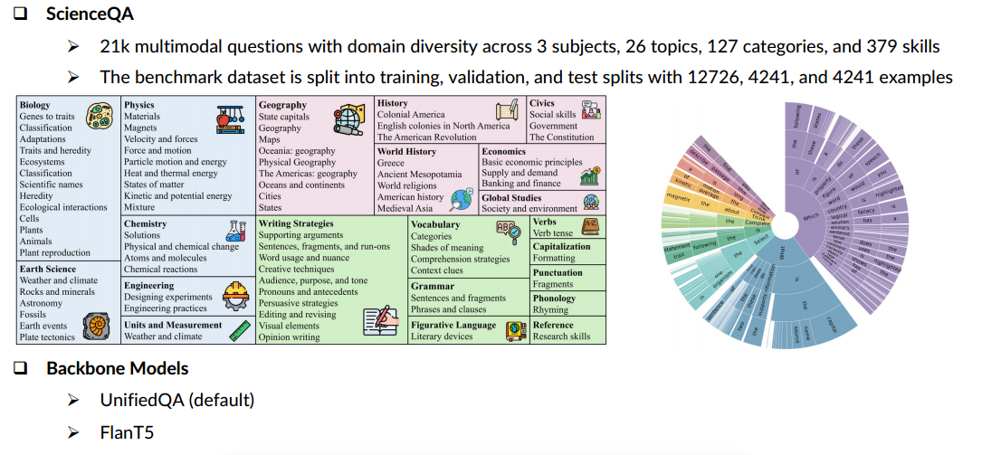
ATAI
Advanced Technique of Artificial Intelligence
ATAI
ChongqingUniversity _{AdvancedTechniqueof}
of Technology Artificial Intelligence
Chongqing University of
Technology
Chongqing University ^{ATAI}
_{of Technology} Advanced Techniqueof
Artificial Intelligence
Chongqing University of Technology
Chongqing University of Technology
Experiments

Slide 16
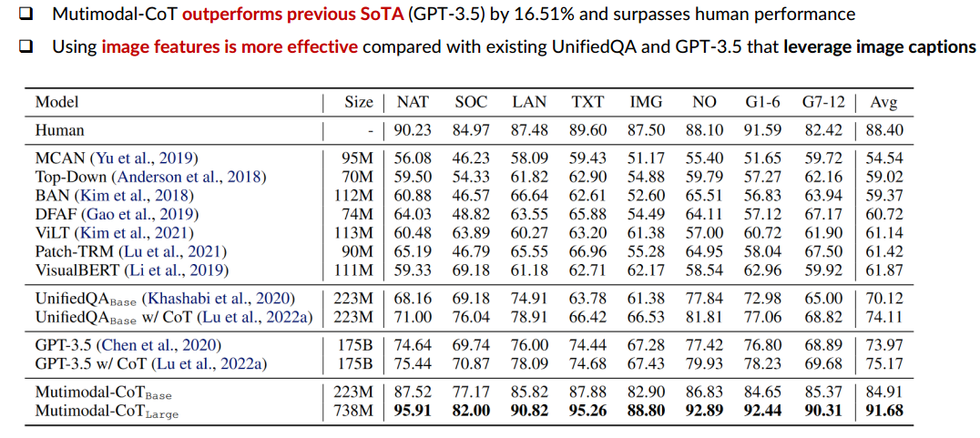
ATAI
Advanced Technique of Artificial Intelligence
ATAI
ChongqingUniversity _{AdvancedTechniqueof}
of Technology Artificial Intelligence
Chongqing University of
Technology
Chongqing University ^{ATAI}
_{of Technology} Advanced Techniqueof
Artificial Intelligence
Chongqing University of Technology
Chongqing University of Technology
Experiments

Slide 17
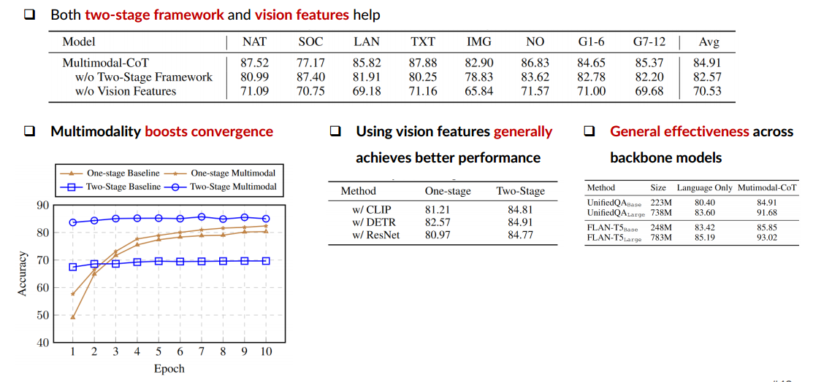
ATAI
Advanced Technique of Artificial Intelligence
ATAI
ChongqingUniversity _{AdvancedTechniqueof}
of Technology Artificial Intelligence
Chongqing University of
Technology
Chongqing University ^{ATAI}
_{of Technology} Advanced Techniqueof
Artificial Intelligence
Chongqing University of Technology
Chongqing University of Technology
Experiments

Slide 18
ATAI
Advanced Technique of Artificial Intelligence
ATAI
ChongqingUniversity _{AdvancedTechniqueof}
of Technology Artificial Intelligence
Chongqing University of
Technology
Chongqing University ^{ATAI}
_{of Technology} Advanced Techniqueof
Artificial Intelligence
Chongqing University of Technology
Chongqing University of Technology
Conclusion
(i) To the best of our knowledge, this work is the first to
study CoT reasoning in different modalities.
(ii) We propose a two-stage framework by fine-tuning language models to fuse vision and language representations
to perform Multimodal-CoT. The model is able to generate
informative rationales to facilitate inferring final answers.
(iii) Our method achieves new state-of-the-art performance
on the ScienceQA benchmark, outperforming accuracy of
GPT-3.5 by 16% and even surpassing human performance.

Slide 19
ATAI
Advanced Technique of Artificial Intelligence
ATAI
ChongqingUniversity _{AdvancedTechniqueof}
of Technology Artificial Intelligence
Chongqing University of
Technology
Chongqing University ^{ATAI}
_{of Technology} Advanced Techniqueof
Artificial Intelligence
Chongqing University of Technology
Chongqing University of Technology
Thanks!

